Slide 1

Local Storage & more
BY : Anjali Sharma

Slide 2
Storage Mechanisms
1 Client-Side Data Storage
Client-Side Data Storage is storing the data on the client (user's machine).
Local Storage
Session Storage
Cookies and many more.
2 Server-Side Data Storage
Server-Side Data Storage is storing the data on the server.

Slide 3
Local Storage
It allows web applications to store data locally within the user's browser.
It is a Storage Object. Data can be stored in the form of key-value pairs.
Note that both key and value must be strings. If their type is other than a string, they get converted to strings automatically.
To access and work with Local Storage we have below methods:
localStorag.setItem()
localStorage.getItem()

Slide 4
Method & example
setItem() Method :-
used for storing data in the Local Storage.
Syntax: localStorage.setItem("Key", "Value");
getItem() Method :-
used for getting data from the Local Storage.
Syntax: localStorage.getItem("Key");
EXAMPLE : -
localStorage.setItem("city", "Delhi");
console.log(localStorage.getItem("city"));

Slide 5
Saving text example
Let's understand how localStorage works and how to implement it with a simple example.
In this example, we want to store a text value that remains saved even after the user closes or refreshes the browser.
We'll start by creating an input field and a "Save" button. Next, we'll attempt to retrieve any existing value from localStorage using getItem.
If a value exists, we'll display it in the input field.
If no value is found, the input will remain empty.
Finally, we'll define a function called saveText that will save the current text to localStorage using setItem.

Slide 6
JavaScript Object Notation (JSON)
JSON is a data representation format used for Storing data (Client/Server), changing data between Client and Server
Supported Types : Number , String, Boolean, Array, Object, Null
In JSON, all keys in an object must be enclosed with double-quotes. While in JS, this is not necessary.
JS :-
let profile = {
name: "Rahul",
age: 29,
designation: "Web Developer“
};
JSON :-
let profile = {
"name": "Rahul",
"age": 29,
"designation": "Web Developer“
};

Slide 7
JSON Method
JSON.stringify() :-
It converts the given value into JSON string.
Syntax: JSON.stringify( value )
JSON.parse():-
It parses a JSON string and returns a JS object.
Syntax: JSON.parse( string )

Slide 8
Coding Practice
Create a simple Mood Tracker web page where users can click on mood buttons and each time they click a button, that mood should be saved and displayed on the screen. The saved moods should stay visible even after the user refreshes or closes the browser.
What Your App Should Do:
Display five buttons, each representing a different mood.
When a user clicks on a mood button, save that mood in the browser using localStorage.
Add a "Clear All Moods" button to remove all saved moods.
When the page reloads, the mood list should still be visible (unless cleared).
Hints :
Use localStorage.getItem("moods") and localStorage.setItem("moods", JSON.stringify(array))
You can store all moods inside an array.
Use JSON.parse() to convert string back to an array.

Slide 9
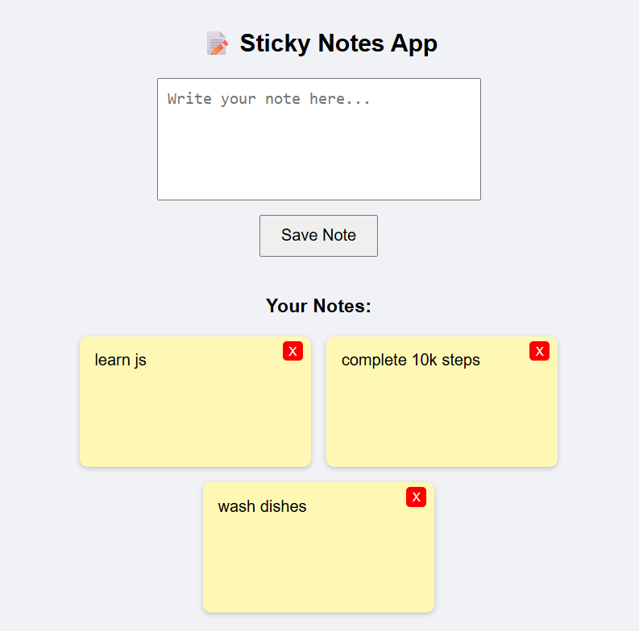
Coding practice -2
Create a Sticky Notes Web App where users can write short notes, save them, view them later, and delete them. All notes should remain visible even after the page is refreshed — thanks to localStorage.
Have a text area where users can type a short note.
A "Save Note" button that saves the note to localStorage.
All saved notes should be displayed below in a card-like style.
Each note should have a "Delete" button to remove that specific note.
Notes should remain saved even after page reload or browser close.

Slide 10

Thank You
ALL THE BEST !!!

